Slide 1
3D – Viewing & Projections

Slide 2
3D Viewing
Viewing: virtual camera
Projection
Visible lines and surfaces
Surface rendering

Slide 3
3D Viewing pipeline 1
Similar to making a photo
  Position and point virtuele camera, press button;
Projection plane and
Viewing plane
Pipeline has +/− same structure as in 2D

Slide 4
3D Viewing pipeline 2
MC: Modeling Coordinates
WC: World Coordinates
VC: Viewing Coordinates
PC: Projection Coordinates
NC: Normalized Coordinates
DC: Device Coordinates
Apply model transformations
To camera coordinates
Project
To standard coordinates
Clip and convert to pixels

Slide 5
Viewing Coordinates
Generating a view of an object in 3D is similar to photographing the object.
Whatever appears in the viewfinder is projected onto the flat film surface.
Depending on the position, orientation and aperture size of the camera corresponding views of the scene is obtained.

Slide 6
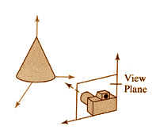
Specifying The View Coordinates
x_{v}
For a particular view of a scene first we establish viewing-coordinate system.
A view-plane (or projection plane) is set up perpendicular to the viewing z-axis.
World coordinates are transformed to viewing coordinates, then viewing coordinates are projected onto the view plane.
y_{v}
y_{w}
z_{v}
P₀=(x₀ , y₀ , z₀)
x_{w}
z_{w}

Slide 7
Specifying The View Coordinates
To establish the viewing reference frame, we first pick a world coordinate position called the view reference point.
This point is the origin of our viewing coordinate system. If we choose a point on an object we can think of this point as the position where we aim a camera to take a picture of the object.

Slide 8
3D viewing coordinates 1
z_{vp}
Specification of projection:
P₀ : View or eye point
P_{ref} : Center or look-at point
V: View-up vector (projection along vertical axis)
z_{vp} : positie view plane
y_{w}
P₀
N
V
P_{ref}
x_{w}
z_{w}
P₀, P_{ref} , V: define viewing coordinate system
Several variants possible

Slide 9
3D viewing coordinates 2
x_{view}
y_{view}
y_{w}
z_{view}
P₀
N
V
P_{ref}
x_{w}
z_{w}
P₀, P_{ref} , V: define viewing coordinate system
Several variants possible

Slide 10
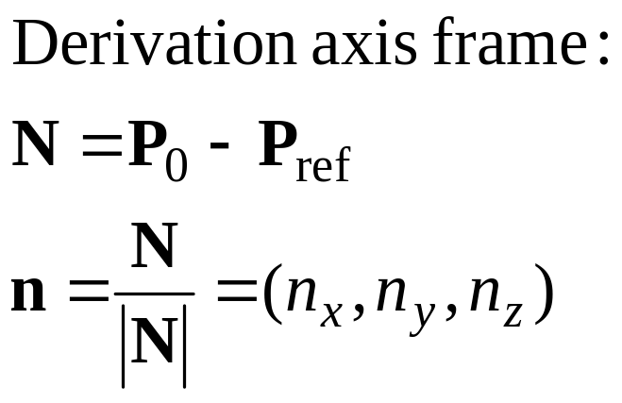
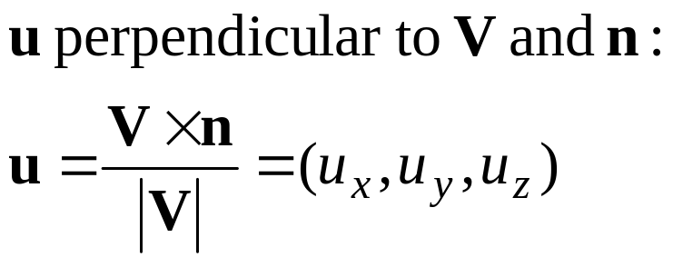
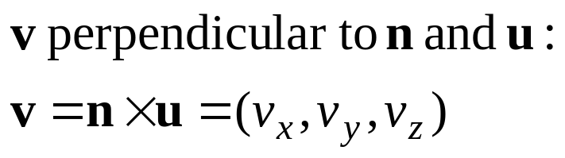
3D view coordinates 3
x_{view}
y_{view}
u
y_{w}
v
z_{view}
n
N
P₀
V
P_{ref}
x_{w}
z_{w}

Slide 11
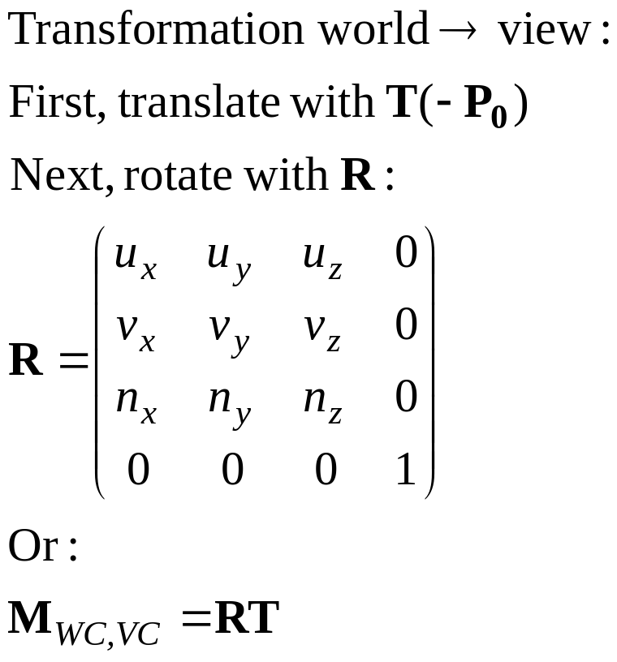
3D viewing coördinaten 4
x_{view}
y_{view}
u
y_{w}
v
z_{view}
n
N
P₀
V
P_{ref}
x_{w}
z_{w}

Slide 12
3D Viewing
Viewing in 3D involves the following considerations: -
  We can view an object from any spatial position, eg. In front of an object, Behind the object, In the middle of a group of objects, Inside an object, etc.
3D descriptions of objects must be projected onto the flat viewing surface of the output device.

Slide 13
Projections

Slide 14
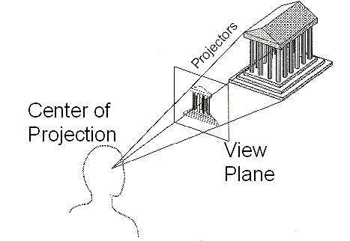
Projection
General definition
  Transform points in n-space to m-space(m<n)
In computer graphics
  Map viewing coordinates to 2D screen coordinates

Slide 15

Taxonomy of Projections
Planar geometric projection
Parallel
Perspective
Orthographic
Oblique
One-point
Three-point
Two-point
Top
Axonometric
Cabinet
Other
Front
Cavalier
Side

Slide 16
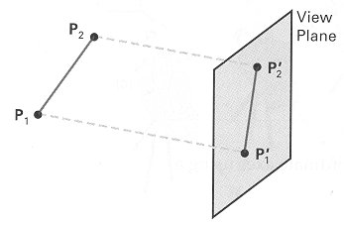
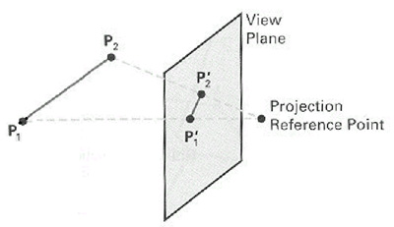
Parallel & Perspective
Parallel Projection
Perspective Projection

Slide 17
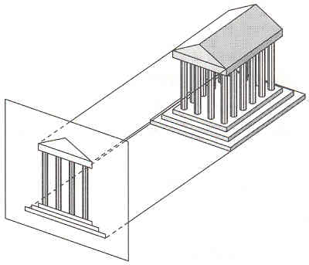
Parallel Projection
Center of projection is at infinity
  Direction of projection (DOP) same for all points
DOP
View Plane

Slide 18
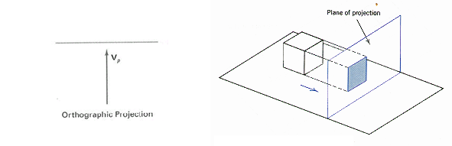
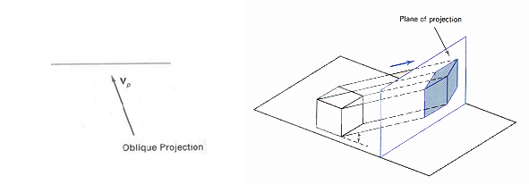
Orthographic & Oblique
Orthographic parallel projection
  the projection is perpendicular to the view plane
Oblique parallel projection
  The projectors are inclined with respect to the view plane

Slide 19
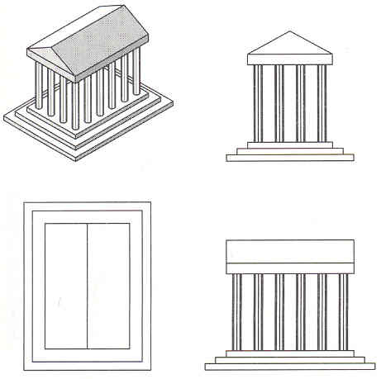
Orthographic Projections
DOP perpendicular to view plane
Front
Top
Side

Slide 20

Oblique Projections
DOP not perpendicular to view plane
  Cavalier
  (DOP at 45 )
  Cabinet
  (DOP at 63.4 )

Slide 21
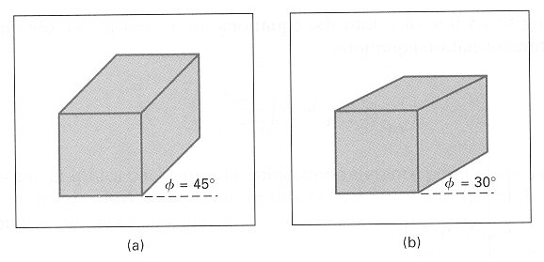

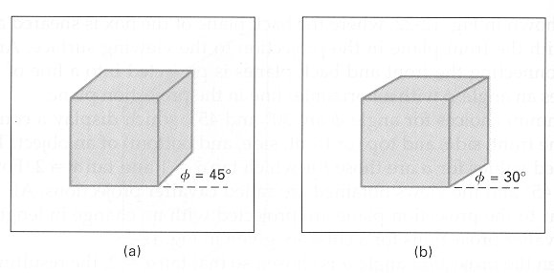

Oblique Projections
DOP not perpendicular to view plane
  Cavalier projection
  Cabinet projection

Slide 22
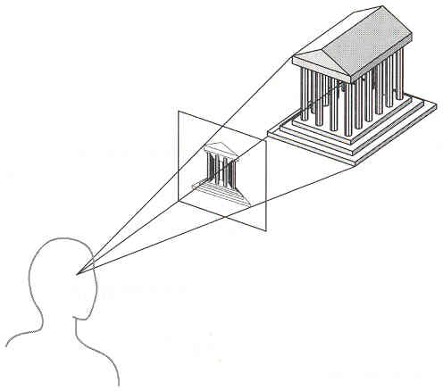
Perspective Projection
Map points onto “view plane” along “projectors” emanating from “center of projection”(cop)
Projectors
Center of Projection
View Plane

Slide 23
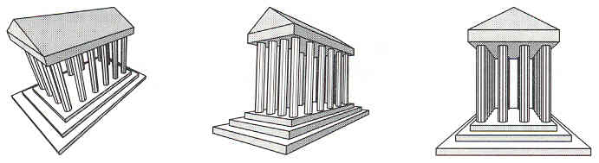
Perspective Projection
How many vanishing point?

Slide 24
Perspective Projection
How many vanishing point?
Three-point perspective

Slide 25
Perspective Projection
How many vanishing point?
Three-point perspective
Two-point perspective

Slide 26
Perspective Projection
How many vanishing point?
Three-point perspective
Two-point perspective
One-point perspective

